Slide 1


DRUG REPURPOSING:
AN EXPLORATORY AND COMPARATIVE STUDY OF FDA-APPROVED DRUGS AS INHIBITORS FOR BREAST CANCER PROTEINS

Slide 2
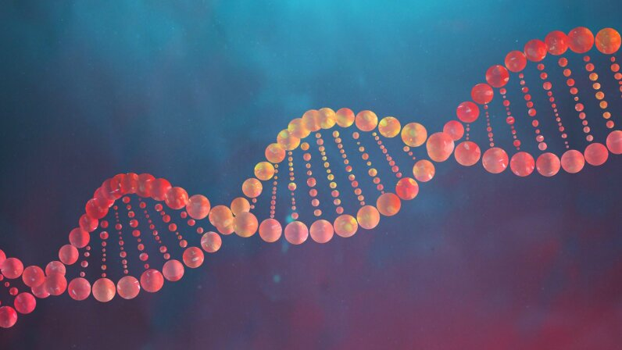
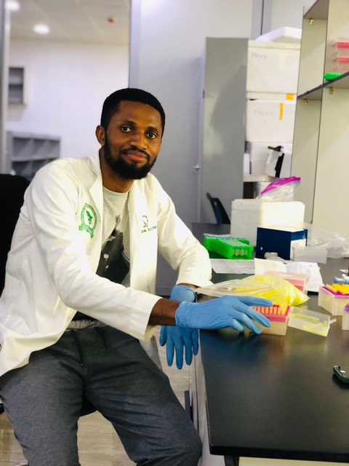
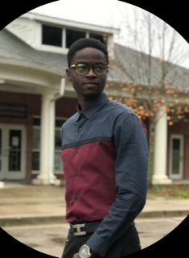

OLEH PRECIOUS
MSc. Biochemistry
Role: Molecular docking and Publication
BEZALEEL AKINBAMI
MSc. BIOINFORMATICS
Role: Molecular docking and Publication

Slide 3

INTRODUCTION
Cancer is a disease caused by the uncontrolled growth of abnormal cells that can invade nearby tissues and spread to other parts of the body.
According to GLOBOCAN, breast cancer is the leading cause of cancer-related deaths among women and the second most common cause of cancer deaths overall.
An effective approach to drug development is drug repurposing, which identifies new uses for existing drugs originally developed for other conditions.

Slide 4
METHODOLOGY
IN SILICO DRUG DISCOVERY WORKFLOW
Curate proteins
(>100)
Curate ligands: FDA-approved drugs.
(>50)
Use databases like; PubChem, DrugBank, etc.
Download 3D structures from PDB and then optimize with PYMOL
Molecular docking:
Preprocess proteins then perform high-throughput docking
ADMET Analysis:
Predict drug properties such as toxicity.
Sort docking based on binding affinities and analyze docking poses with PYMOL.
STATISTICAL ANALYSIS
Heatmap
ANOVA

Slide 5
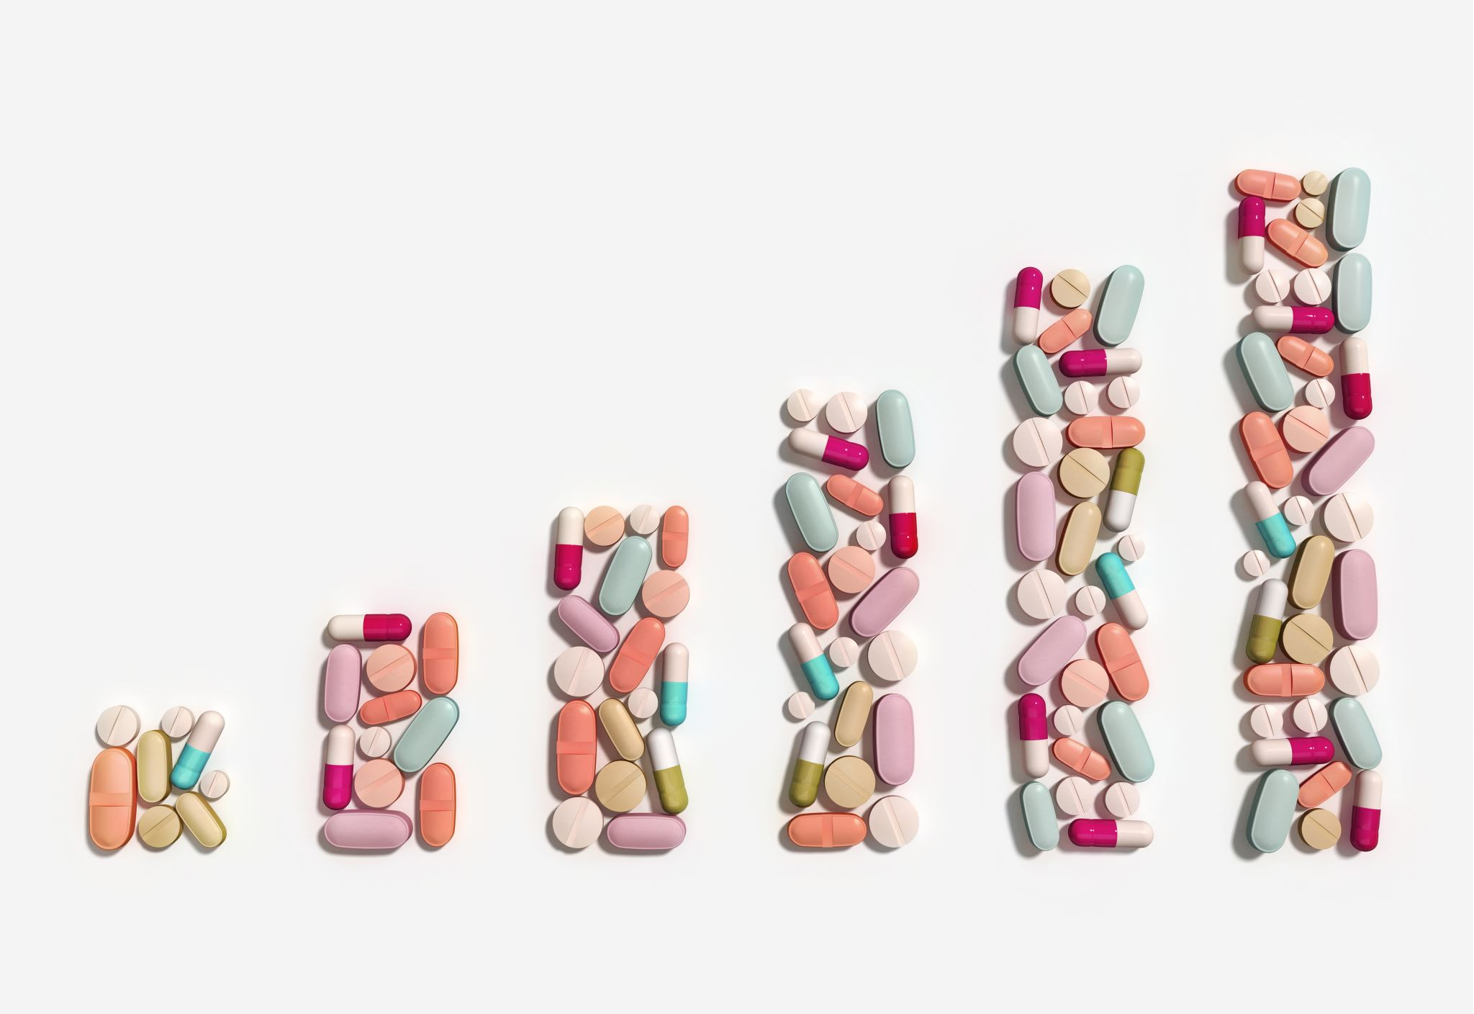
EXPECTED OUTCOME
Discover potential drugs for repurposing
To determine the binding affinities of these drugs to cancer-related genes
To determine if there’s a significant difference among the group of repurposed drugs.
To determine if there’s a significant difference among the types of protein structures (apo, antagonist, agonist) and the repurposed drugs.
To determine the repurposed drugs with the least side effects through ADMET prediction

Slide 6


